Slide 1

Vortex remote access sign-up for tutorial assignments

Slide 2
CuPBoP: CUDA for Parallelized and Broad-range Processors
Chihyo(Mark) Ahn

Slide 3
Agenda
Related works
CuPBoP workflow
CuPBoP Runtime Functions
Compilation
How to Run CuPBoP
Code Structure
Step-by-step Tutorial
Supporting Benchmarks

Slide 4
Related Works

Slide 5

CUDA compilation process
CUDA program
host code
LLVM IR
FAT Binary
kernel code
NVVM IR
PTX Assembly
Front-end Compilation
(Clang)
NVPTX
Codegen

Slide 6
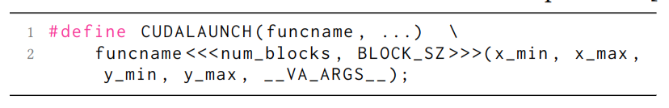
CUDA compilation process
Source to source translation
Pros:
Lightweight, easy to debug and maintain
Cons:
CUDA is based on C++, the grammar is too complicated to be fully covered
Highly depends on the similarity between CUDA and target languages
DPCT, HIPIFY
CUDA program
host code
LLVM IR
FAT Binary
kernel code
NVVM IR
PTX Assembly
Front-end Compilation
(Clang)
NVPTX
Codegen

Slide 7
CUDA compilation process
Reverse Engineering
Pros:
No need to re-compile CUDA programs;
Cons:
No official open-sourced PTX parser, hard to maintain and update with latest CUDA.
Ocelot
CUDA program
host code
LLVM IR
FAT Binary
kernel code
NVVM IR
PTX Assembly
Front-end Compilation
(Clang)
NVPTX
Codegen

Slide 8
CUDA compilation process
Support CUDA migration on LLVM/NVVM IR level
Pros:
No need to handle complicated CUDA grammar.
NVIDIA teams maintain the Clang-CUDA compilation, always up-to-date.
Based on LLVM, which is fully open-sourced.
CuPBoP
CUDA program
host code
LLVM IR
FAT Binary
kernel code
NVVM IR
PTX Assembly
Front-end Compilation
(Clang)
NVPTX
Codegen

Slide 9
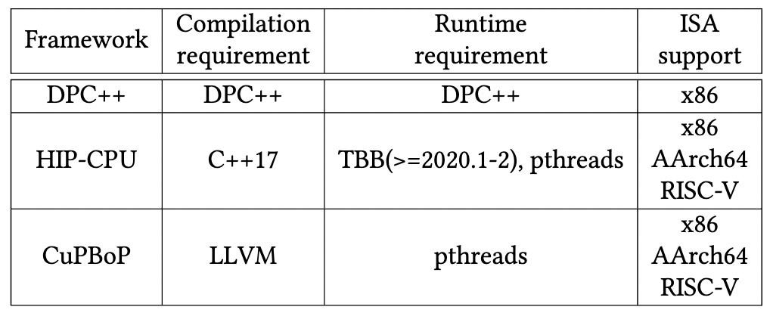
Supported Hardware backend
CuPBoP can execute CUDA on x86, AArch64, and RISC-V backends

Slide 10
CuPBoP Framework

Slide 11
CuPBoP framework
CUDA program
kernel code
NVVM IR
Translated NVVM IR
Kernel
Executable
Executable file
host code
LLVM IR
Translated
LLVM IR
Host
Executable
Kernel Wrapper
CuPBoP Runtime library
Vortex Kernel
Library
Vortex Runtime
Front-end
Compilation
(Clang)
CuPBoP
Compilation
Transformations
Backend
Compilation
Link
Process

Slide 12
CuPBoP framework
CUDA program
kernel code
NVVM IR
Translated NVVM IR
Kernel
Executable
Executable file
host code
LLVM IR
Translated
LLVM IR
Host
Executable
Kernel Wrapper
CuPBoP Runtime library
Vortex Kernel
Library
Vortex Runtime
1
Front-end
Compilation
(Clang)

Slide 13
CuPBoP framework
CUDA program
kernel code
NVVM IR
Translated NVVM IR
Kernel
Executable
Executable file
host code
LLVM IR
Translated
LLVM IR
Host
Executable
Kernel Wrapper
CuPBoP Runtime library
Vortex Kernel Library
vx_spawn_threads (…)
Vortex Runtime
2
CuPBoP
Compilation
Transformations

Slide 14
CuPBoP framework
CUDA program
kernel code
NVVM IR
Translated NVVM IR
Kernel
Executable
Executable file
host code
LLVM IR
Translated
LLVM IR
Host
Executable
Kernel Wrapper
CuPBoP Runtime library
Vortex Kernel
Library
Vortex Runtime
3
Backend
Compilation

Slide 15
CuPBoP framework
CUDA program
kernel code
NVVM IR
Translated NVVM IR
Kernel
Executable
Executable file
host code
LLVM IR
Translated
LLVM IR
Host
Executable
Kernel Wrapper
CuPBoP Runtime library
Vortex Kernel
Library
Vortex Runtime
4
Link
Process

Slide 16
CuPBoP framework
CUDA program
kernel code
NVVM IR
Translated NVVM IR
Kernel
Executable
Executable file
host code
LLVM IR
Translated
LLVM IR
Host
Executable
Kernel Wrapper
CuPBoP Runtime library
Vortex Kernel
Library
Vortex Runtime
Front-end
Compilation
(Clang)
CuPBoP
Compilation
Transformations
Backend
Compilation
Link
Process

Slide 17
CuPBoP framework
CUDA program
kernel code
NVVM IR
Translated NVVM IR
Kernel
Executable
Executable file
host code
LLVM IR
Translated
LLVM IR
Host
Executable
Kernel Wrapper
CuPBoP Runtime library
Vortex Kernel
Library
Vortex Runtime
Implement CUDA APIs for non-NVIDIA devices
Front-end
Compilation
(Clang)
CuPBoP
Compilation
Transformations
Backend
Compilation
Link
Process

Slide 18
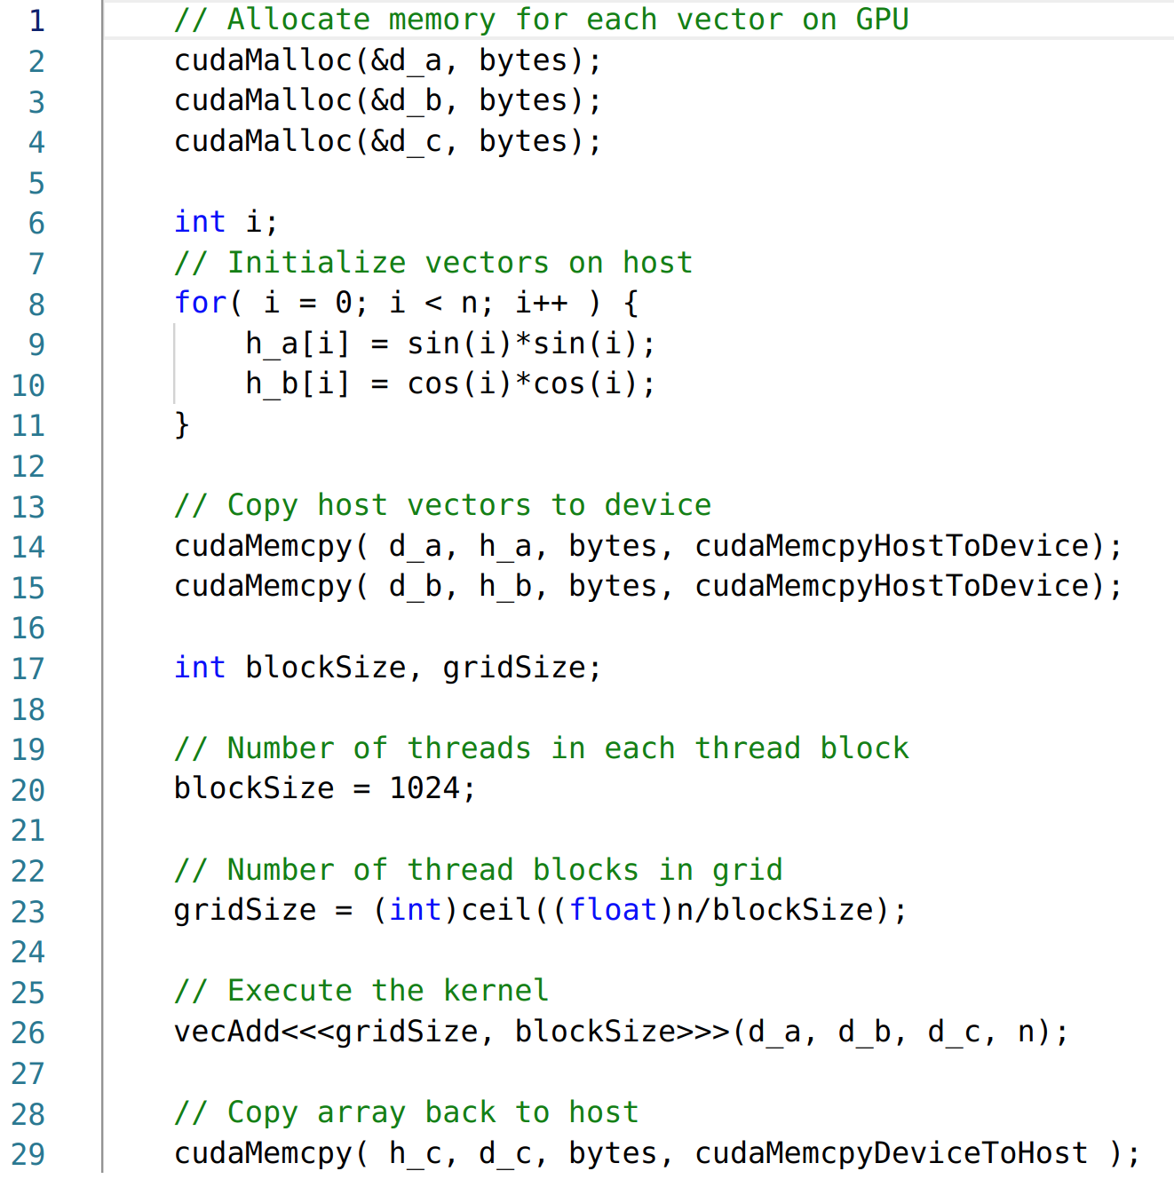
Case study: CUDA Runtime Functions
How should we handle CUDA Runtime functions?

Slide 19
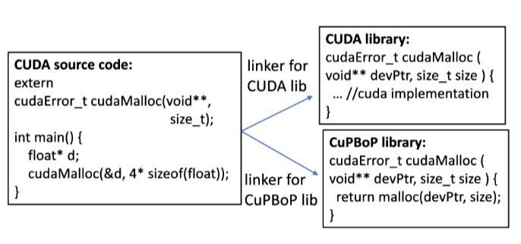
CuPBoP Runtime (CUDA API Implementation)
Vortex Runtime
…
vx_mem_alloc(…)
…
By changing the link path, CUDA code can be executed on Vortex without modifications.
To support a new CUDA API, the developers only need to implement the new API in the library.

Slide 20
CuPBoP Runtime (CUDA Kernel Launching Implementation)
…
cudaMalloc(&d_a, bytes);
cudaMalloc(&d_b, bytes);
cudaMalloc(&d_c, bytes);
…
int blockSize = 1024;
int gridSize = (int)cell((float)n/blockSize);
vecAdd<<<gridSize, blockSize>>>
(d_a, d_b, d_c, n);
…
Vortex Runtime
cudaLaunchKernel_vortex(…) {
… vx_upload_kernel_file(…);
…
vx_upload_bytes(…); // upload args
vx_start(…); // spawn vortex task
vx_ready_wait(…); // sync for task finish
…
}
cudaLaunchKernel(…)
offloading CUDA kernel on Vortex device and launch it via Vortex APIs by modifying the link path

Slide 21
CuPBoP framework
CUDA program
kernel code
NVVM IR
Translated NVVM IR
Kernel
Executable
Executable file
host code
LLVM IR
Translated
LLVM IR
Host
Executable
Kernel Wrapper
CuPBoP Runtime library
Vortex Kernel
Library
Vortex Runtime
Front-end
Compilation
(Clang)
CuPBoP
Compilation
Transformations
Backend
Compilation
Link
Process

Slide 22
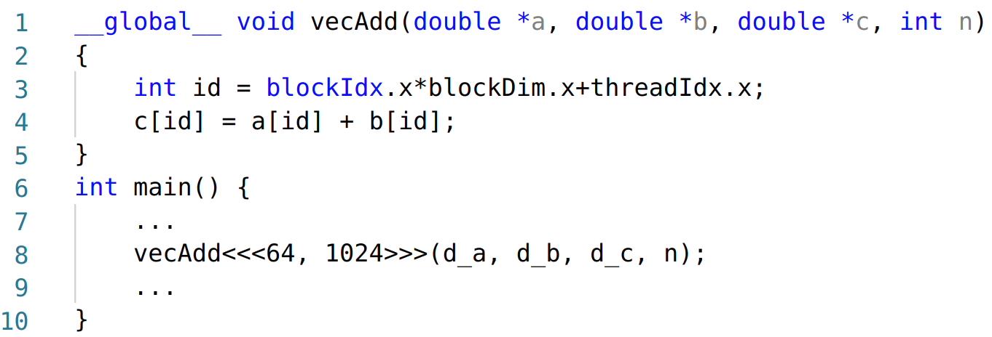
CuPBoP compilation
When the targeted architecture is significantly different from NVIDIA GPU...
There are 64K CUDA threads, much less than the number of active threads in Vortex.
The workload for each thread is too lightweight for each Vortex Thread.

Slide 23
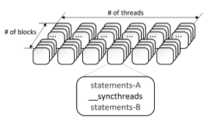
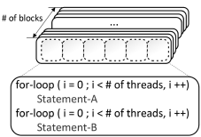
Mapping CUDA Threads to Vortex
Step1:
Analyze the Parallel Region[1]
(the regions between barriers that must be executed by all the threads before proceeding to the next region.)
[1] Jääskeläinen, Pekka, et al. "pocl: A performance-portable OpenCL implementation." International Journal of Parallel Programming 43.5 (2015): 752-785.

Slide 24
Mapping CUDA Threads to Vortex
Step1:
Analyze the Parallel Region[1]
(the regions between barriers that must be executed by all the threads before proceeding to the next region.)
Step2:
Wrap each Parallel Region with a single-layer for-loop.
[1] Jääskeläinen, Pekka, et al. "pocl: A performance-portable OpenCL implementation." International Journal of Parallel Programming 43.5 (2015): 752-785.

Slide 25
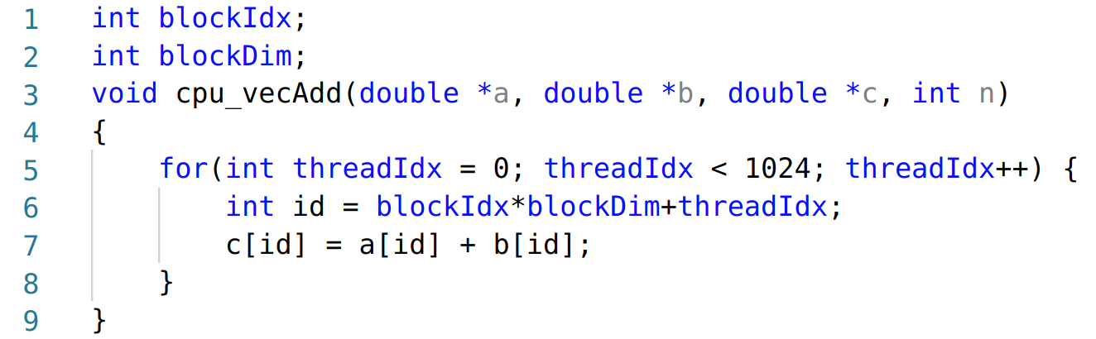
Mapping CUDA Kernel to Vortex
64K threads are required
The workload for each thread is too lightweight for each Vortex Thread for efficient execution
Compilation Transformations
Only 64 threads are required
The workloads are much heavier, which is more friendly to Vortex HW.

Slide 26
Mapping CUDA Kernel to Vortex: Thread Mapping
Vortex
Core
Core
Warp
Warp
Thread
Block
…
Thread
Thread
Kernel Instance
Thread Mapping: Each CUDA Block mapped to each Vortex HW thread

Slide 27
Mapping CUDA Kernel to Vortex: Core Mapping
Vortex
Core
Core
Warp
Warp
Thread
Block
…
Thread
Thread
Kernel Instance
Core Mapping: Each CUDA Block mapped to each Vortex Core
Can Make Better Use of HW Resources when:
Linear (Coalesced) Memory Access between adjacent Cuda threads.
When #of CUDA Blocks < Total Vortex HW threads

Slide 28
CuPBoP Compilation Passes Overview
Vortex
CUDA processing model
Thread
Block
Kernel execution instance
Vortex Warps
Thread
Warp
Core
Core
Core
Warp
Warp
Thread
Block
…
Thread mapping
Thread
Thread
Core mapping
Kernel Instance
Generate Wrapper
for Kernel Launch
Support CUDA Shared, Const. Mem.
Thread Flat Collapsing
Handle Synchronizations
Optimization Passes
…

Slide 29
CuPBoP Tutorial

Slide 30
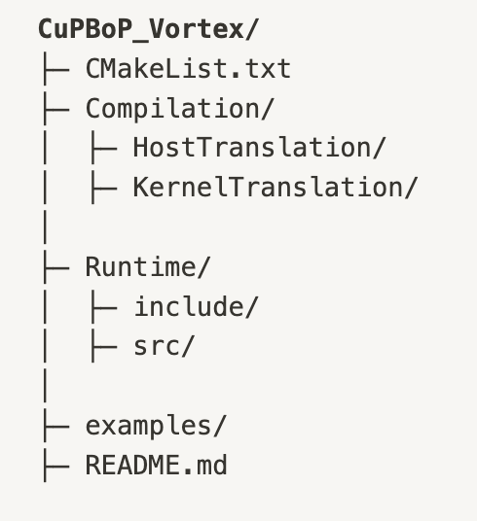
CuPBoP code structure
CuPBoP compilation part Most code is about LLVM transformations.
CuPBoP runtime library, implements two kinds of CUDA APIs:
Runtime function (e.g., cudaMalloc) : functions be executed on the host
Kernel function (e.g., nv_powf) : functions be executed on the device
Rodinia: Used for verification the correctness

Slide 31
How to Use CuPBoP
Step 0: Build CuPBoP
Requirements:
Linux system (verified: Ubuntu 18.04, 20.04)
LLVM 14 (in the process of upstream it to Vortex LLVM)
CUDA toolkit (CuPBoP needs CUDA toolkit to compile the source programs to NVVM/LLVM IRs.)
CMake
Vortex (with its dependencies)

Slide 32
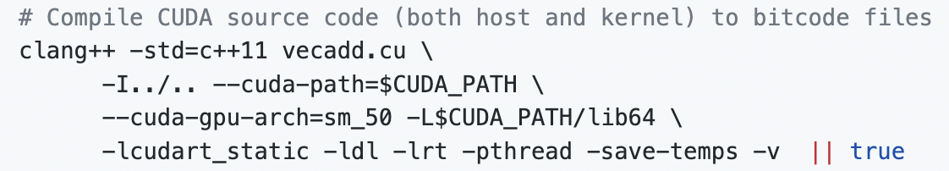
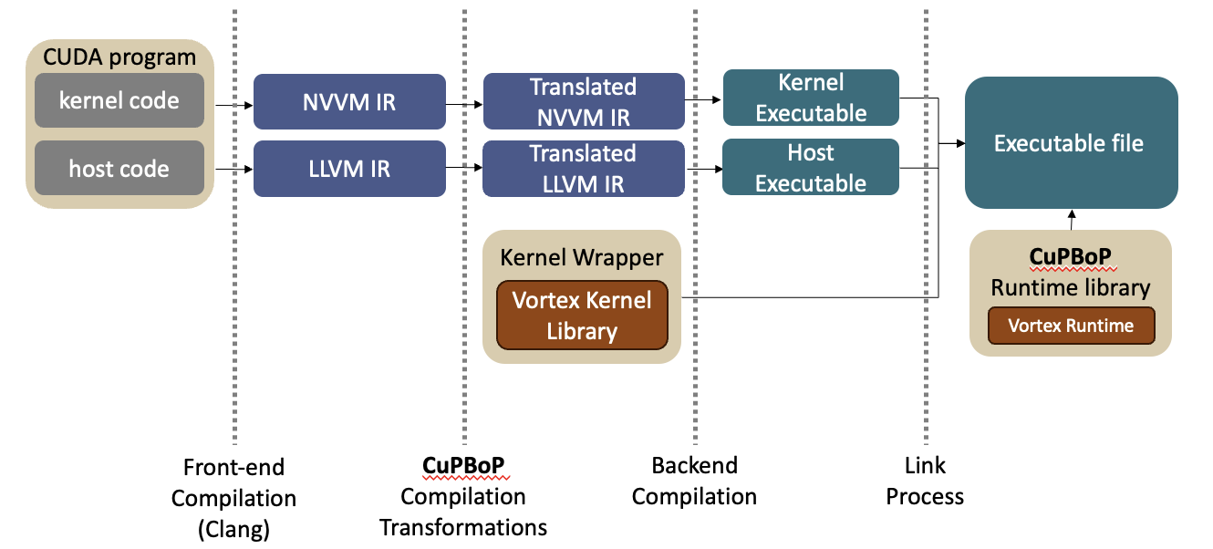
How to Use CuPBoP
Step 1: Compile CUDA programs to NVVM/LLVM IRs
This will generate two IR Files:
NVVM IR (Kernel)
vecadd-cuda-nvptx64-nvidia-cuda-sm_50.bc for
LLVM IR (Host)
vecadd-host-x86_64-unknown-linux-gnu.bc for

Slide 33
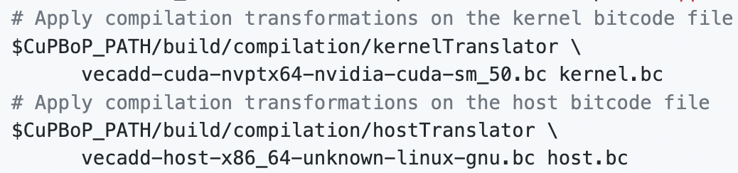
How to Use CuPBoP
Step 2: Apply transformations on both IRs. (CuPBoP compilation part)
CuBBoP will translate original IRs into
kernel.bc
host.bc

Slide 34
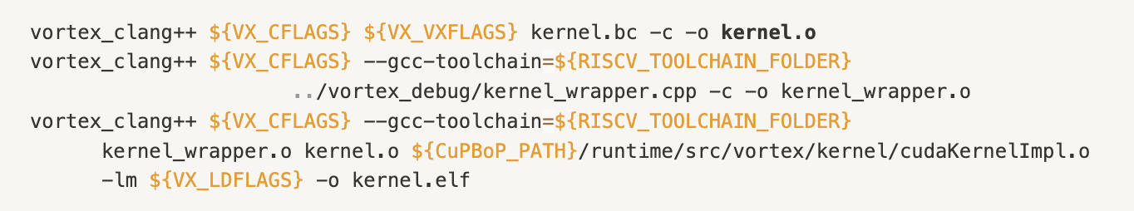
How to Use CuPBoP
Step 3: Back-end Compilation (Kernel)
Kernel
Kernel.bc is compiled for Vortex target.
Kernel Wrapper is compiled to be linked
Kernel functions, such as math library, are linked to create the kernel executable.

Slide 35
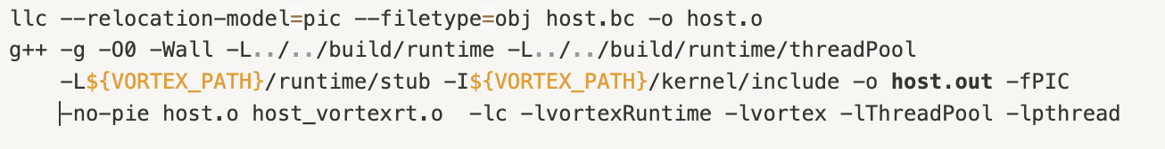
How to Use CuPBoP
Step 4: Back-end Compilation (Host)
Host
Host.bc is compiled for Vortex target.
CuPBoP Runtime library gets linked to generate final executable

Slide 36
Evaluation (Rodinia)
Benchmark Name | feature | Support (64bit)
Gauss | Multi-kernel in series | O
BFS | - | O
NN | Math Library (sqrt) | O
NW | Shared Mem. | O
Srad_v2 | Shared Mem. + Syncthreads | O
Hotspot | Shared Mem. + Syncthreads | O
StreamCluster | Constant Mem. | O
Myocyte | - | O
Pathfinder | Shared Mem. + Syncthreads | O
LUD | Shared Mem. + Syncthreads | O
Btree | - | O
Backprop | __powf, __log2f | O
CFD | CudamemcpytoSymbol + Constant Memory | △
Huffman | Atomics | X

Slide 37


Q&A
Thanks for your time!
CuPBoP(x86) is an open-source project on Github.
(Vortex CuPBoP is coming soon!)
x86 CuPBoP’s performance optimization paper will be presented here in MICRO 2024
We welcome any kinds of contribution & feedback.
CuPBoP link: https://github.com/cupbop/CuPBoP
Related papers:
CuPBoP: CUDA for Parallelized and Broad-range Processors

